Slide 1

Well-being at Work
Cara Fox Fairbanks, SPHR, CWPM
WhiteWater Wellness LLC

Slide 2
How We Talk about it…
Wellness = Absence of illness/disease
Wellness = Minimal risk of disease
This comes from a focus on disease management
Results in a limited, narrow view of wellness
Clinical thinking is critical in “sick care” but only part of the picture in wellness.
Notes:
This focus has value when you’re focusing on claims management or clinical treatment but has very little to do with true wellness

Slide 3
What IS Wellness?
What is it to YOU?
What makes YOU thrive?

Slide 4
Wellness is the art and science of getting people to practice healthy habits [regardless of their health status].
Notes:
It’s impossible to discriminate because you’re not focusing on health.

Slide 5

Five Elements of Well-Being
Career well-being
Social well-being
Financial well-being
Physical well-being
Community well-being
Well-being is about the combination of our love for what we do each day, the quality of our relationships, the security of our finances, the vibrancy of our physical health, and the pride we take in what we have contributed to our communities. It’s about how these five elements interact.”
- Well Being by Tom Rath, Jim Harter

Slide 6

66% of people are doing well in at least one of these areas
7% are thriving in all five
Biggest threat to wellbeing = ourselves
Career wellbeing: most essential of the 5
  Do you like what you do each day?
  Boosts your chances of reaching wellbeing in other areas

Slide 7

How are we doing?
As of 2014...
Ranked #1
Source: Gallup Healthways Well-Being Index 2014, state ranking out of 50, city ranking out of 189

Slide 8
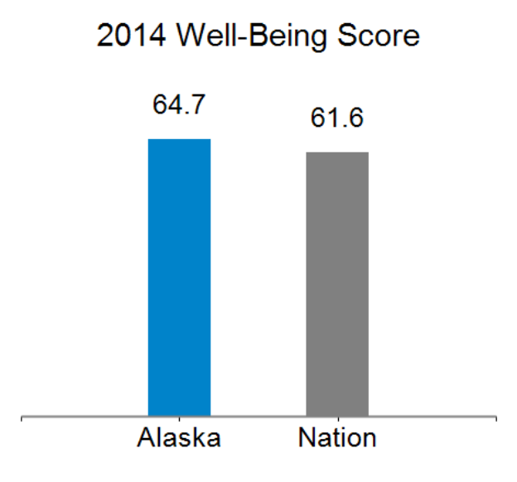
Our score fluctuates…
Alaska Well Being
Element | Rank
Purpose | 1
Social | 7
Financial | 2
Community | 3
Physical | 2
Year | Rank
2014 | 1
2013 | 16
2012 | 31
2011 | 4
2010 | 4
2009 | 5
2008 | 11

Slide 9
Alaska’s Health Stats (CDC)
Source: CDC Behavioral Risk Factor Surveillance System Data

Slide 10
Why are we talking about this at work?

Slide 11
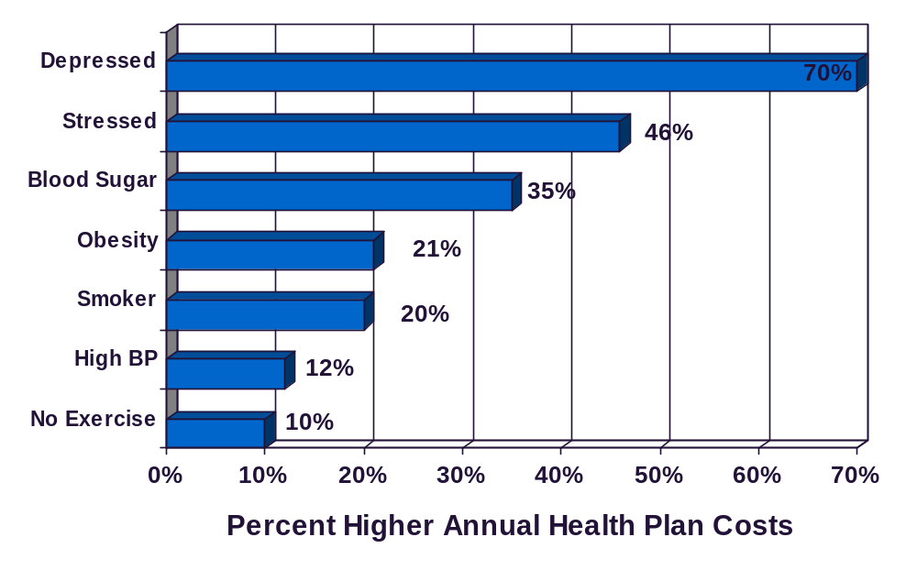
Health Risks Increase Health Costs
N = 46,000+ X 3years
Source: Goetzel RZ, et al. (1998, October). The relationship between modifiable health risks and health care expenditures: An analysis of the multi-employer HERO health risk and cost database. JOEM, 40(10):843-54

Slide 12
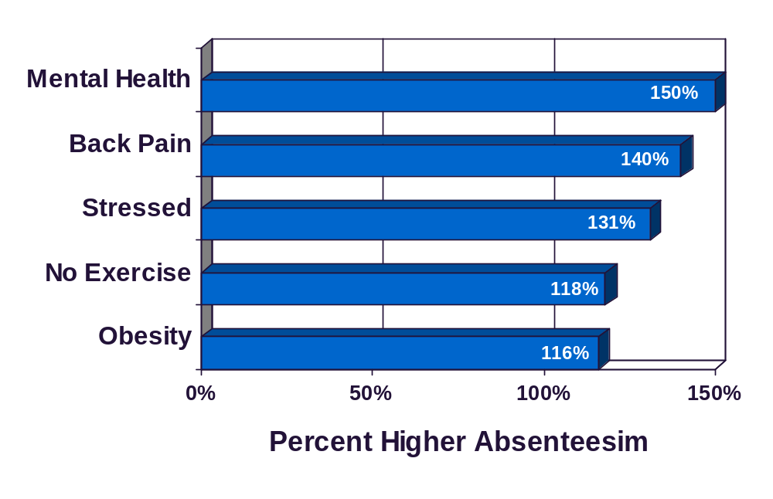
Health Risks Increase Absenteeism
N = 35,451
Source: Serxner, S., et al., (2001). The impact of behavioral health risks on worker absenteeism. JOEM, 43(4), 347-354.

Slide 13
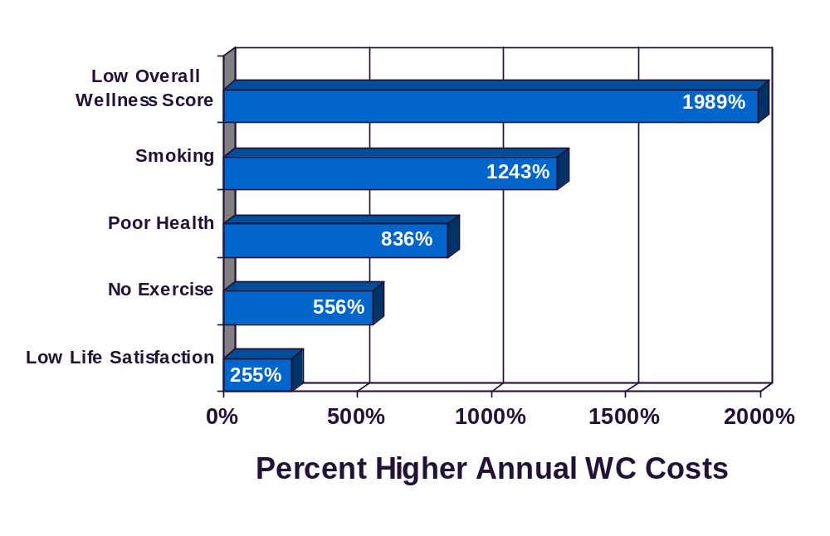
Health Risks Increase Workers Comp Costs
N = 3,388 X 4 years
Source: Musich, S., et. al., (2001, June). The Association of Health Risks with Workers’ Compensation Costs, JOEM, P. 534-541

Slide 14
Sedentary Culture
Americans sit 11 hours a day
Muscles are inactive 70-80% of our waking hours
Burn 51,000 calories less per year than 50 years ago
1 in 10 adults have trouble walking a distance equal to walking from the parking lot to the back of a large store or through a mall.

Slide 15

Your Body on Prolonged Sitting
Less oxygen to brain
Inhibited learning, concentration, motivation
Slower metabolism of fat and cholesterol
Fat burning enzymes shut down after a couple hours
Circulation slows, increased fatigue, sore muscles/joints
Higher rates of diabetes and heart disease
More likely to die (from all causes)
Regardless of other exercise!!!

Slide 16
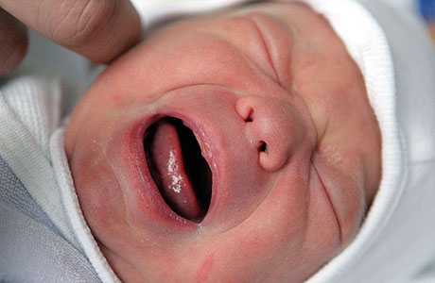

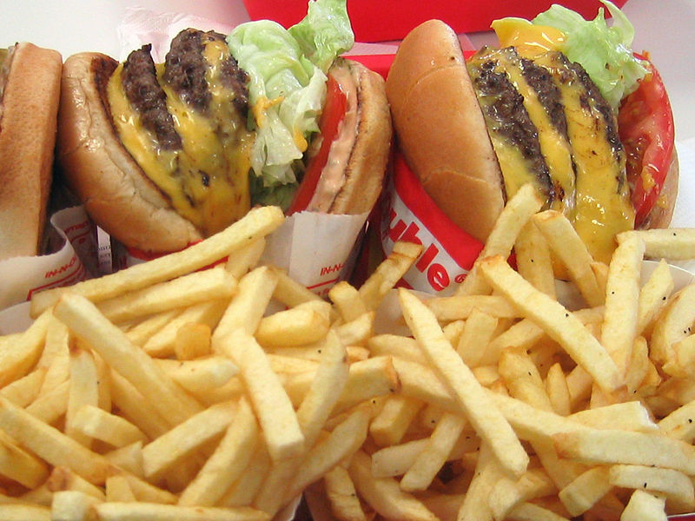

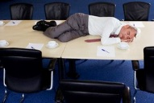
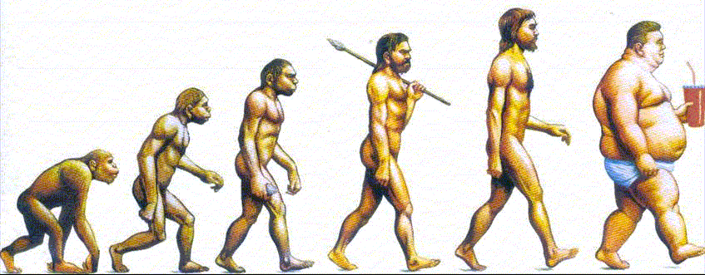
Consequences of Current Culture:
Health Benefits
Sick Leave
Workers Comp
STD & LTD (Disability)
FMLA
Presenteeism
Morale/Turnover
Loyalty
Productivity
Accuracy
Quality of work and life
=
Notes:
In a sense, presenteeism is the opposite of absenteeism, in which the employee does not come to work. The term "presenteeism" was coined by Professor Cary Cooper, a psychologist specializing in organizational management at Manchester University in the UK.
Presenteeism is defined as lost productivity that occurs when employees come to work but perform below par due to any kind of illness.
Someone who is present but not fully accounted for…not fully functioning.
Illness, low morale, poor attitude…contribute to productivity losses at work.
In a 1999 study sponsored by the Employers Health Coalition – Costs of lost productivity are 7.5 times greater than costs due to absenteeism.
Depression, back pain, arthritis, heart disease, high blood pressure, allergies, cold/flu, gastrointestinal disorders.

Slide 17
How do we tackle this?

Slide 18

Key Ingredients for Success
Management support (top down)
Employee support (bottom up)
Goals & objectives
Strategy & plan
Measurement
Feedback (both ways)
Management Support
Employee
Support
Cultural Support
Notes:
Culture = comes from cultivate = from agriculture…
Cultivate a place where people are going to come in and thrive in being healthy. There is individual responsibility but the likelihood of people doing it within a supportive environment is much greater

Slide 19
Program Components & Variations
General Focus
Participation Focus
Disease management
Health & well-being
Morale (fun, team-building)
Work-life balance
Individualized
Group-based
Voluntary
Involuntary
Scope of Program
Participant Experience
Passive
Active & empowered
Comprehensive
Campaign-based or issue-based

Slide 20
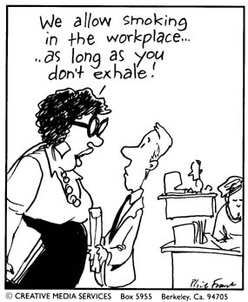
Delivery
Level of Integration
Among wellness plan components
With company policies & practices
With health plan
On-site
Online
Other technology (i.e. mobile devices)
Off-site
Combination
Source
Private vendor
Insurance company
One or multiple public sources
In-house

Slide 21

Incentives
Group based
Individual
Competition
Money or financial
Tangible or intangible
Carrot vs. Stick
Integration with health plan
“Entry fee” concept
Loss aversion

Slide 22

The Incentive Debate…
They CAN (and DO) change behavior
  But does it last?
Which is better, the carrot or the stick?
Do incentives kill intrinsic motivation?
Some incentives are not so obvious…
Be thoughtful & cautious in design of incentives

Slide 23
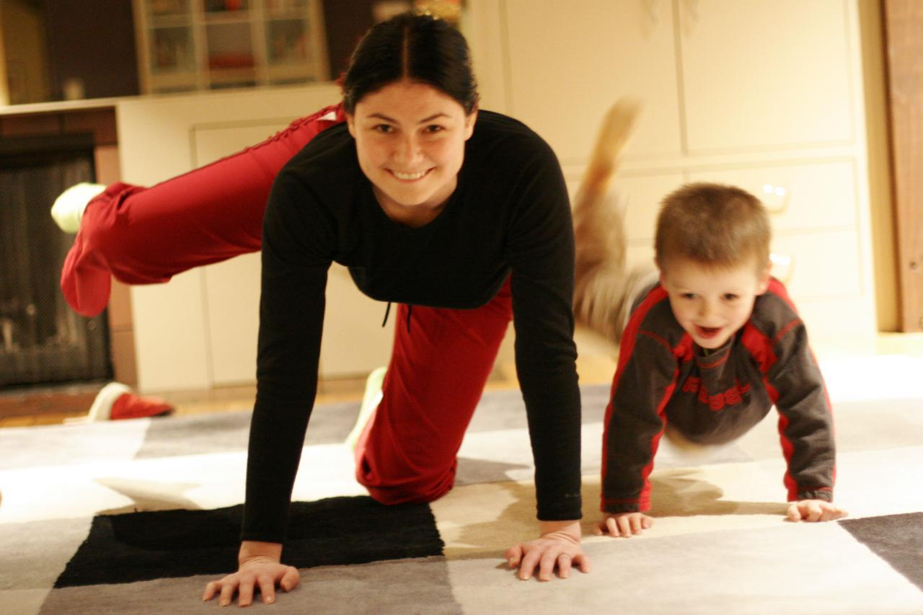
An incentive will get someone to try something new, but people have to see someone they know and trust doing that behavior before they are willing to make a permanent change.

Slide 24

Legal & Compliance Considerations
Regulating bodies:
  IRS, DOL, HHS
(Potential) Applicable laws and regulations:
  ERISA: HIPAA, COBRA
  GINA: Genetic Information Nondiscrimination Act
  ACA (Affordable Care Act)
  IRC: taxation of incentives
  ADA (Americans with Disabilities Act)
  Civil Rights Act of 1964 (Title VII)
  State laws
Is your wellness program part of or linked to a group health plan?
  i.e. discounted premiums based on health factors

Slide 25
Do you have to follow ACA rules?
Participatory Plans
Health Contingent Plans
Rewards based on participation only, no health factors
Offered to all similarly situated individuals
DOES NOT HAVE TO MEET THESE REQUIREMENTS
Rewards based on meeting a standard related to a health factor
Two categories:
  Activity-Only
  Outcome-Based
BOTH MUST MEET THE REQUIREMENTS OUTLINED IN THE REGULATIONS (But they differ slightly)

Slide 26
Realistic Expectations (Range)
Participation
Low
5%-25%
High
65%-95%
Annual Cost Per Employee
<$50
$250+
ROI
<1:1
2.5:1 to 6.5:1
When evaluating programs, ask how is participation measured?
Consider administration time in cost
ROI is tricky to measure

Slide 27

Measuring Success
How you measure your success depends largely on your goals & objectives
Why bother?
  Refine and improve your program going forward
  Justify the use of resources
  Get employees excited about participation
Potential measures and metrics:
  Business Performance
  Claims costs, other associated costs
  Change in Personal Health Assessment scores
  Employee satisfaction surveys – can look at many variables
  Use of sick days (absenteeism)
  Number of employees who smoke
  Employee engagement
  Individual success stories
  Turnover
  Disability claims
  Safety incidents
  Participation
  Workers comp claims
  Cultural norms
Notes:
If you don’t have access to claims costs, look at how many claims over $10,000, ER visits, drug use, etc.

Slide 28
What shapes our behaviors:
 | People | Spaces | Head Space | Systems
Motivation
Capability
Inertial Force
Barriers
Motivation + Capability > Barriers + Inertial forces
Notes:
Shared Values: closely held belief by an individual about the appropriate way to approach living
Norm: A rule or standard of bx shared by members of a social group
Touch points: practices that strongly influence norms
Peer Support – is the help that people give each other to achieve a healthy lifestyle
Climate – has to do with whether people get along and are inspired by what the organization is all about. Dimensions of climate:

Slide 29
Where to Start?
Define your purpose, budget, and approach
Designate a wellness team or person
Look at past efforts – what’s worked, what hasn’t?
Take stock of current policies/facilities – do they promote or inhibit healthy practices
Get familiar with your employees
  Demographics
  Related metrics
  Particular interests
Define your goals and objectives
Notes:
Which components of the models appeal to you? Budget may dictate this somewhat.
Include a representative from different sectors of your company in your wellness team – use employee input
Talk to “long-timers” to find out if there has been any efforts in the past
I can help you with looking at policies and procedures that encourage or discourage healthy behaviors…also facilities modification
Demographics – should be easy through HR
Metrics – absenteeism (specifically sick leave or unplanned absences), turnover (and reasons for), productivity (overall performance of company), workers comp claims, disability claims, health claims (and premiums), etc.
Interests – some will be obvious; consider employee survey – can measure degree of readiness to change – can also get input on things they would like to see as part of a wellness program…build buy-in
Use this information to define goals and objectives.

Slide 30
Back to the 5 Elements…
Career Well Being
Supportive management
Growth opportunities
Appreciation
Strong communication
Social Well Being
Encourage social networks at work & outside of work
Financial Well Being
Financial education
Retirement planning
Fair/Competetive Pay
Physical Well Being
Movement at work
Support healthy eating
Worksite wellness programs
Prevention focused health plan
Flexible scheduling
Community Well Being
Volunteer opportunities & group outings
Company support of community initiatives

Slide 31
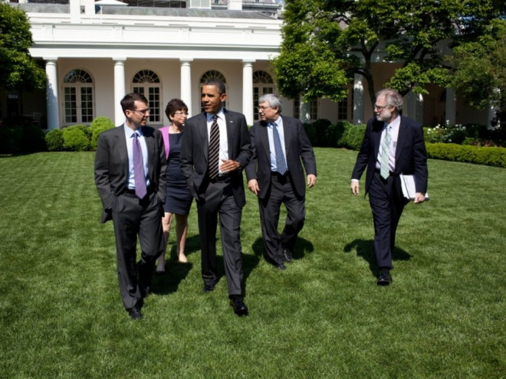
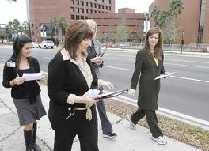
How to Move More at Work
Standing work stations
Walking work stations
Biking work stations
Walk vs. email/phone
Walking meetings
Gym meetings
Take a break every hour
Support alternative commuting
Park farther away

Slide 32
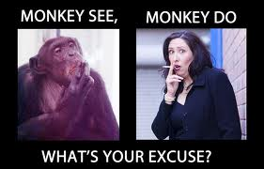
Are YOU a Wellness Leader?
Walk the talk
Be a wellness ally
Find supporters
Build support
Make it a part of your business’ strategic plan, mission, vision, etc.

Slide 33
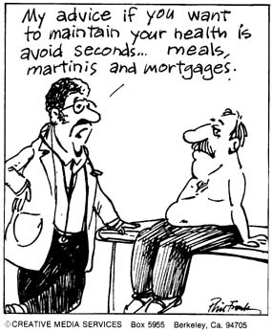
Most people spend their years sacrificing their health to gain their wealth, only later to spend their wealth reclaiming their health.

Slide 34
Resources
Welcoa: www.welcoa.com
Centers for Disease Control (CDC): www.cdc.gov/nccdphp/dnpao/hwi/index.htm
National Wellness Institute (NWI): www.nationalwellness.org
LinkedIn Groups
State of Alaska: www.hss.state.ak.us/dph/chronic/worksite/default.htm
HERO Scorecard: http://hero-health.org/scorecard/

Slide 35
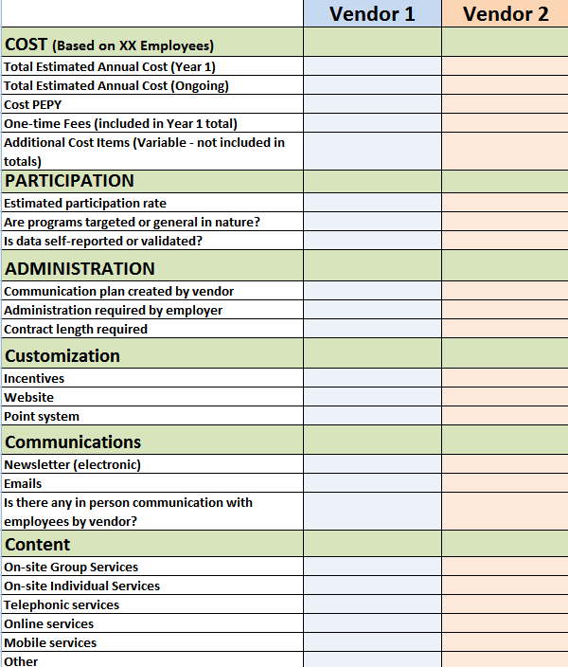
Make a comparison chart
Compare the things that are really important to you
Modify as you learn more
Have vendor give presentation
See it in action

Slide 36
Questions?
cara@whitewaterwellness.com
907-223-4883

