Slide 1
Physical Activity Promotion in the worksite
The Benefits of Physical Activity
Regular physical activity is one of the most important things you can do for your health. It can help:
  Control your weight
  Reduce your risk of cardiovascular disease
  Reduce your risk for type 2 diabetes and metabolic syndrome
  Reduce your risk of some cancers
  Strengthen your bones and muscles
  Improve your mental health and mood
  Improve your ability to do daily activities and prevent falls, if you're an older adult
  Increase your chances of living longer
http://www.cdc.gov/physicalactivity/basics/pa-health/index.htm

Slide 2
Physical Activity Promotion in the worksite
The Benefits of Physical Activity
Regular physical activity is one of the most important things you can do for your health. It can help:
Others?

Slide 3
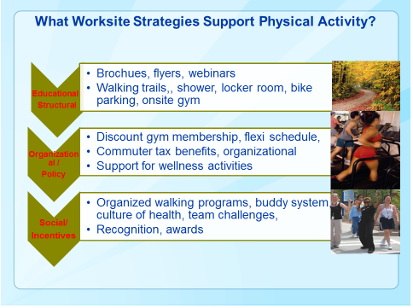
Physical Activity Promotion in the worksite

Slide 4
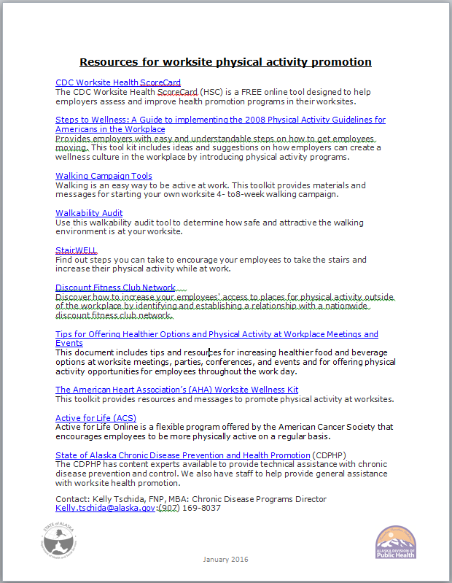
Physical Activity Promotion in the worksite
Getting started:

Slide 5
Physical Activity Promotion in the worksite
Resources for worksite physical activity promotion
CDC Worksite Health ScoreCard
The CDC Worksite Health ScoreCard (HSC) is a FREE online tool designed to help employers assess and improve health promotion programs in their worksites.
Steps to Wellness: A Guide to implementing the 2008 Physical Activity Guidelines for Americans in the Workplace
Provides employers with easy and understandable steps on how to get employees moving. This tool kit includes ideas and suggestions on how employers can create a wellness culture in the workplace by introducing physical activity programs.
Walking Campaign Tools
Walking is an easy way to be active at work. This toolkit provides materials and messages for starting your own worksite 4- to8-week walking campaign.
Walkability Audit
Use this walkability audit tool to determine how safe and attractive the walking environment is at your worksite.
StairWELL
Find out steps you can take to encourage your employees to take the stairs and increase their physical activity while at work.
Discount Fitness Club Network
Discover how to increase your employees' access to places for physical activity outside of the workplace by identifying and establishing a relationship with a nationwide discount fitness club network.
Tips for Offering Healthier Options and Physical Activity at Workplace Meetings and Events
This document includes tips and resources for increasing healthier food and beverage options at worksite meetings, parties, conferences, and events and for offering physical activity opportunities for employees throughout the work day.
The American Heart Association’s (AHA) Worksite Wellness Kit
This toolkit provides resources and messages to promote physical activity at worksites.
Active for Life (ACS)
“Active for Life Online is a flexible program offered by the American Cancer Society that encourages employees to be more physically active on a regular basis.”
State of Alaska Chronic Disease Prevention and Health Promotion (CDPHP)
The CDPHP has content experts available to provide technical assistance with chronic disease prevention and control. We also have staff to help provide general assistance with worksite health promotion.
Contact:
Kelly Tschida, FNP, MBA
Chronic Disease Programs Director Kelly.tschida@alaska.gov, (907) 169-8037

