Slide 1
Tobacco Prevention & Control
Help your employees quit tobacco & save money!
Presenter:
Eliza Muse, MSc Health Care Policy
Alaska Tobacco Prevention & Control

Slide 2
Percent of Adults Who Smoke, by Year, Alaska and US, 1996 & 2014

Slide 3
Declines in Tobacco Use
Change in social norms
Community-wide smoke free ordinances
Public and private smoke and tobacco free workplace policies
Tobacco taxes
Counter-marketing efforts
Notes:
Declines in tobacco use are attributable to the change in social norms due to community wide smoke free ordinances which reduce exposure to visibility of people engaging in smoking and also the exposure to SHS. Also, public and private smoke and tobacco free workplace policies which reduce exposure and can also go a step further in protecting workers and the community. For example, here in Anchorage there is a community smokefree workplaces law, but it currently does not include electronic cigarettes. If you wanted to protect your employees and work towards reducing social norms around electronic cigarette use you could implement an individual workplace policy that includes electronic cigarettes.
Increase the price of tobacco has also contributed to the declines in tobacco use, especially among youth and young adults who are very sensitive to price.
Countermarketing efforts, such as those the state creates showing the harms of SHS and also the benefits of quitting tobacco are also a very effective strategy in reducing tobacco use prevalence.

Slide 4
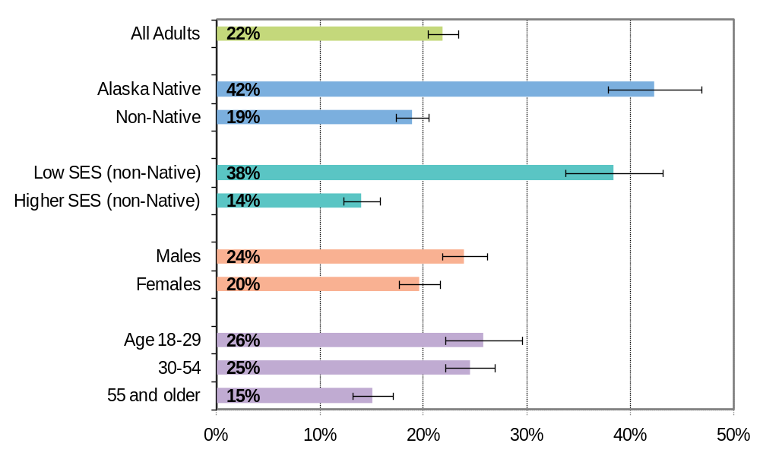
Percent of Adults Who Smoke, by Selected Demographic Factors, Alaska, 2013
Source: Alaska BRFSS
Notes:
Despite these great declines: There are disparities.
The graph above shows that adult smoking is significantly higher among non-Native adults of low SES (38.4%) and among Alaska Native adults (42.3%), than their counterparts.
About 2 in 5 Alaska Native adults currently smoke, compared to 1 in 5 non-Native adults.
Among non-Native adults age 25 to 64, those of low SES are nearly three times as likely as those of higher SES to be smokers.
Younger adults remain a priority group for tobacco prevention efforts. In 2013, approximately 1 in 4 young adults age 18 to 29 (25.8%) as well as 1 in 4 adults aged 30 to 54 (24.5%) reported current smoking. This proportion remains significantly higher than the smoking prevalence for adults age 55 and older.
More than half of adults who were current smokers in 2013 (56.9%) reported that they had started smoking before they were 18 years old.
Among non-Native current smokers, adults of low SES were significantly more likely than those of higher SES to have started smoking before age 18 (69.3% versus 50.9%).

Slide 5
2015 Challenges
Source: 2015 YRBS
Notes:
And our new challenge are electronic cigarettes, which are slowly enticing our youth and addicting a new generation to nicotine.
36% of teens have ever tried e-cigarettes
18% of Alaska high school students reported current use compared to 11% of AK teens who smoke cigarettes
Boys use more than girls (20% compared to 15%)
Hispanic youth use: 33.7%
1 in 4 high school girls and more than 1 in 3 high school boys are using some form of nicotine

Slide 6
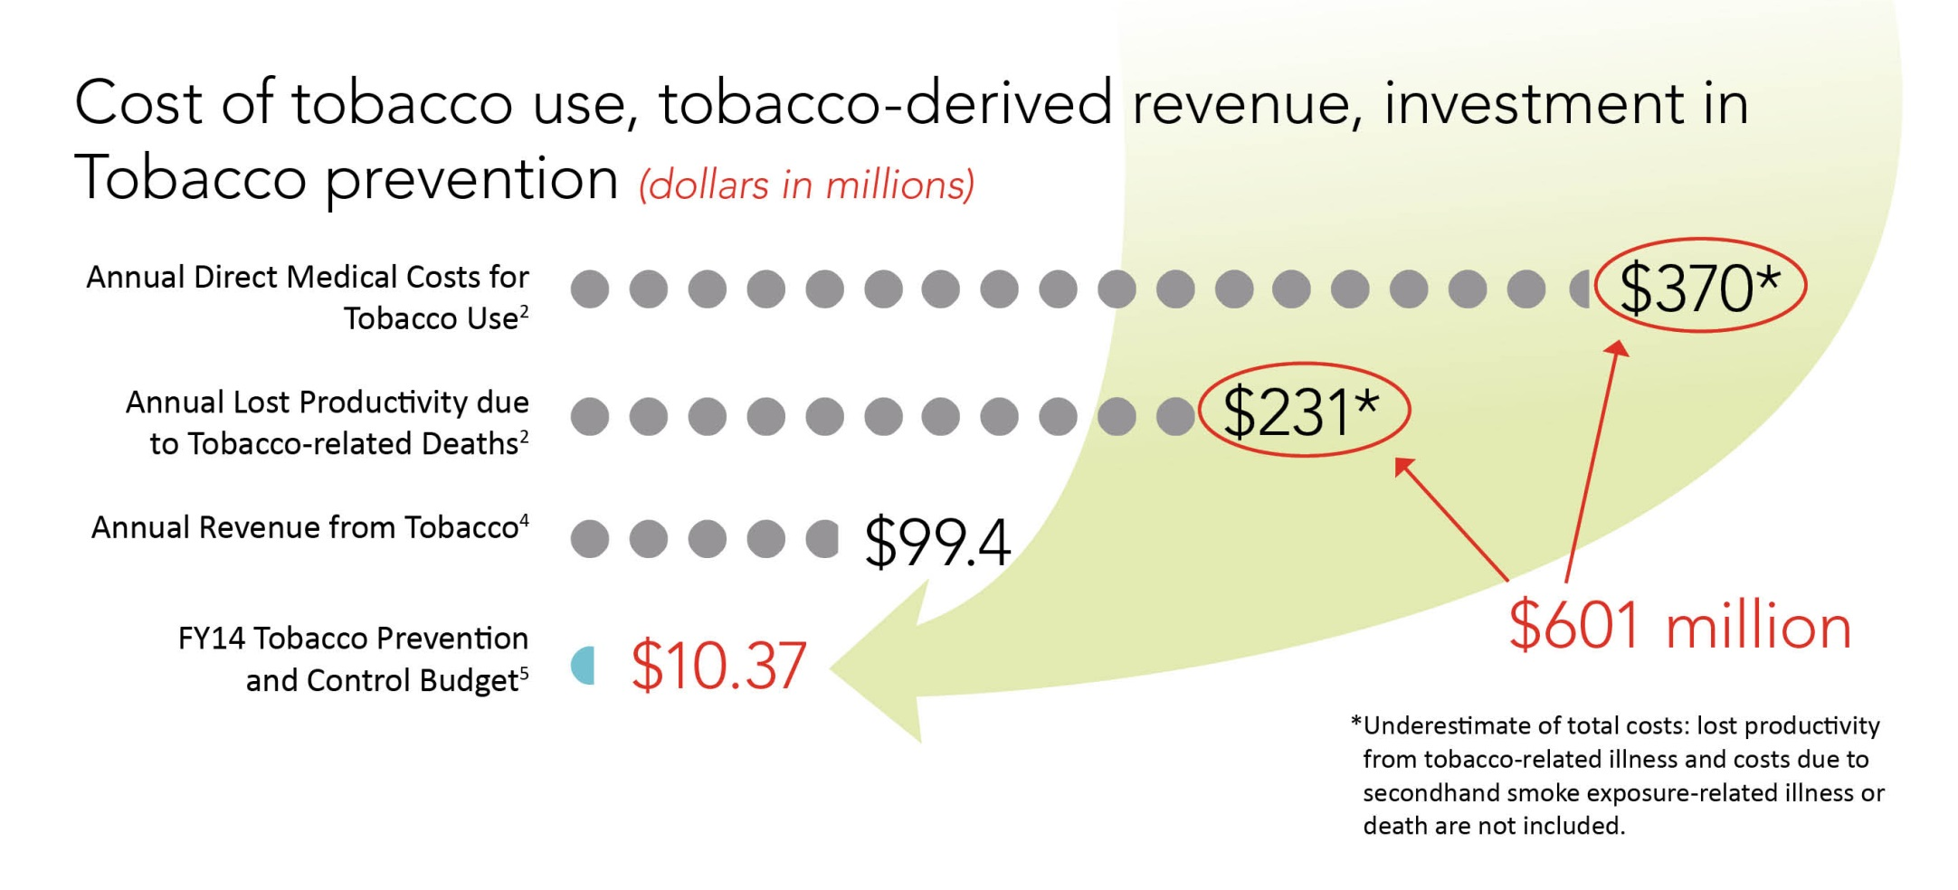
Costs of Tobacco Use
Source: Alaska Tobacco Facts and Alaska Revenue Sources Book, Fall 2014
Notes:
And this deadly addiction cost ALL Alaskans.
In Alaska, the annual direct medical cost for tobacco use is $370 million dollars. The annual cost of lost productivity due to tobacco related deaths are $231 million. That amounts to a whopping 601 million annually. Which are actually underestimates since they do not include lost productivity from tobacco related and illnesses due to secondhand smoke exposure related illnesses and deaths.

Slide 7
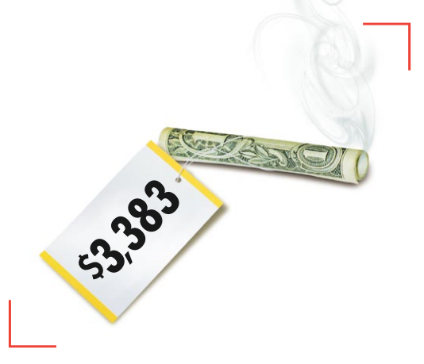
Want To Cut Costs?
Lost Productivity - $1,760
Annual Medical Expenditures - $1,623
Per Person
Source: CDC
Notes:
$3,383 a year. That’s how much you pocket as a company for every employee who kicks the habit. Or how much you lose in higher health care costs, lost workdays, and time off for smoke breaks if your employees don’t quit.
Smoking costs a business an estimated $1,760 in lost productivity per smoker per year. In addition, each smoker incurs an estimated $1,623 in smoking-attributable annual medical expenditures. Factors in estimating these costs include:
• Increased absenteeism (six days/year for smokers vs. four days/year for nonsmokers)
• Work time spent on smoking breaks (18 – 22 days/year)
• Higher life insurance premium costs
• Greater risk of occupational injuries
• Costlier disability payments
• More disciplinary actions
This amount was taken from the CDC Centers for Disease Control and Prevention Annual Smoking-Attributable Mortality, Years of Potential Life Lost, and Economic Costs. United States 1995-1999. MMWR 2002; 51: 300- 30

Slide 8
What can you do?
Smokefree and Tobacco Free Workplaces (including e-cigs).
  Lower Your Costs
  Reduce Your Liability
  Protect Your Employees’ Health
  Reduce Absenteeism
  Increase Productivity and Morale
Notes:
In order to prevent tobacco use, we must change our communities and our built environments; asking individuals to change their behavior while they still live, work and play in communities that support tobacco use is not fair and it won't work.
• Businesses pay an average of $2,189 in workers’ compensation costs for smokers, compared with $176 for nonsmokers.1 • Smoking costs employers an estimated $3,383 per smoker per year, comprised of $1,623 in direct medical expenditures and $1,768 in lost productivity.2 • The National Fire Protection Association found that in 1998, smoking materials caused 8,700 fires in nonresidential structures, resulting in direct property damage of $60.5 million.3 • Fire insurance is commonly reduced 25% to 30% in smoke-free businesses.4
Having a smoke-free workplace reduces the risk of lawsuits being filed by employees who become ill from breathing secondhand smoke. • Disability claims based on secondhand smoke exposure are eliminated. A smoke-free workplace prevents violation of the Americans with Disabilities Act which can occur when people with respiratory problems have limited access or cannot patronize or work in your business due to tobacco smoke pollution.
Smokers, on average, miss more days of work per year due to sickness compared to nonsmokers. Halpen, M.T.; Shikiar, R; Rentz, A.M. Khan, Z.M., Impact of Smoking Status on Workplace Absenteeism and Productivity, Tobacco Control 10(3): 233-238, September 2001.
Employees who take four 10-minute breaks a day to smoke actually work about three weeks less per year than workers who don’t take smoking breaks. • A tobacco-free workplace is more attractive to employees, since 87% of Alaskans agree that people should be protected from secondhand smoke.

Slide 9
3 Steps To Making Your Worksite Tobacco Free
Use your company’s health plan to help employees and their families quit tobacco.
Encourage the use of free tobacco cessation services, Alaska’s Tobacco Quit Line 1-800-QUIT-NOW and alaskaquitline.com.
Develop, communicate, maintain, and enforce a comprehensive tobacco-free campus or business policy.
Notes:
When reviewing current health plans or bidding for a new one, benefits managers can incorporate some or all of the following tobacco dependence treatment questions into written specifications:17 • How does the health plan identify and document tobacco users and tobacco cessation interventions? • What tobacco cessation medications are covered? How frequently are these offered, and for what period annually? Are multiple medications covered? Are multiple quit attempts covered in one 12-month period? • What type of counseling (e.g. in person, online, telephone) is covered, how often is counseling covered annually, and for what period (e.g. 90 days twice per year)?
Quitting tobacco isn’t easy. Businesses can provide critical support to employees by establishing a policy to refer all tobacco-using employees to cessation programs proven to work. Alaska has free services available for your employees. Using the quitline in conjuction with cessation coverage available through your company’s health plan, employees who use the Alaska’s Tobacco Quit Line and Alaskaquitline.com are more likely to quit tobacco.
A tobacco-free workplace makes good business sense and creates a supportive setting for employees who want to quit using tobacco. To successfully transition to a tobacco-free environment, develop a written policy and ensure that all employees and visitors are aware of it.

Slide 10
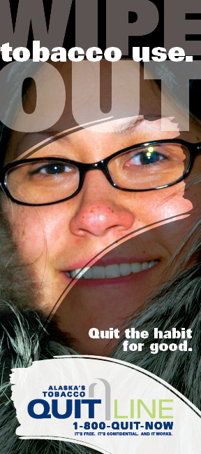
Alaska’s Tobacco Quit Line
1-800-QUIT-NOW
alaskquitline.com
7 days a week, 24 hours a day
All Alaska adults eligible for services
Free, confidential, & it works!
30% quit rate
Free promotional products for your business
Notes:
110 different languages, including yupik.
Eligible for free NRT.
Enroll online, over the phone.
Text 2 quit.

Slide 11
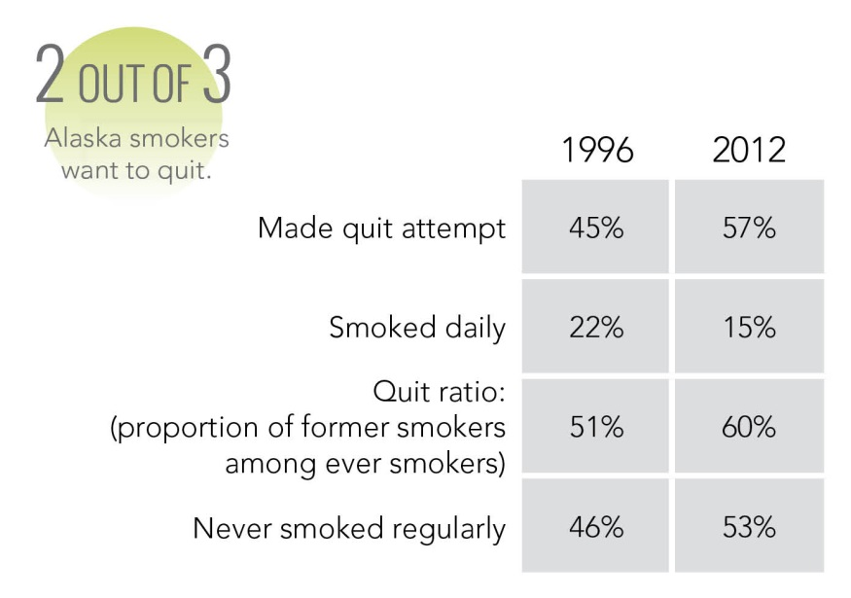
Cessation Progress
Notes:
In FY14, 2,683 Alaskans received counseling and free nicotine
replacement therapy. The program was expanded this year
to include Web Coach and Text2Quit to give more support
options for a successful quit attempt.
Since 1998, the tobacco industry has increased addiction
components in tobacco products. Cessation support is more
vital now than ever before.
Just remember that 72% of Alaskan Tobacco Users WANT TO QUIT, 57% have attempted a quit last year. The quitline is a great resource that used in conjuction with smoke and tobacco free policies can boost a person’s chance of quitting for good.

Slide 12
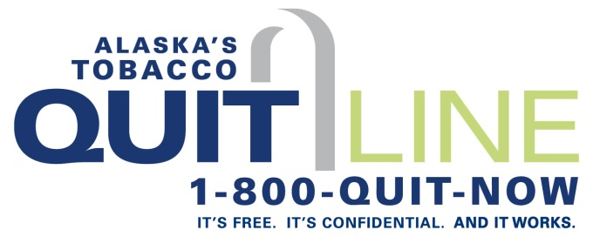
Resources
Alaska Tobacco Prevention & Control Program
  www.tobaccofree.alaska.gov
Alaska’s Tobacco Quit Line
  www.alaskaquitline.com or 1(800)QUIT-NOW

Slide 13
Want more information?
Eliza Muse
Alaska Tobacco Prevention & Control
(907) 269-0465
Eliza.Muse@alaska.gov

