Slide 1
Top 10 Trends: Next Generation Wellness
Cara Fairbanks, SPHR, CWPM, SHRM-SCP

Slide 2
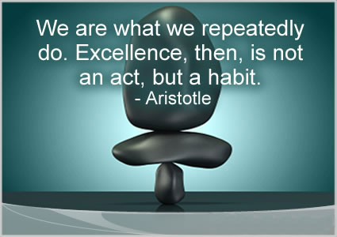
10. Habit Focused

Slide 3
9. Holistic
Well-Being
Career
Social
Financial
Physical
Community

Slide 4
8. Multidisciplinary & Integrated
Worksite Norms
Support of Co-Workers
Policies
Benefits & Programs
Systems
Light, Space, view of nature
Alternative Work Stations
Environment
Company Culture
Past Experiences
Locus of Control
Head Space

Slide 5
7. High Tech, BYOD, Connected

Slide 6
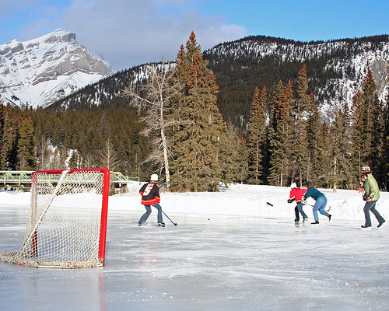
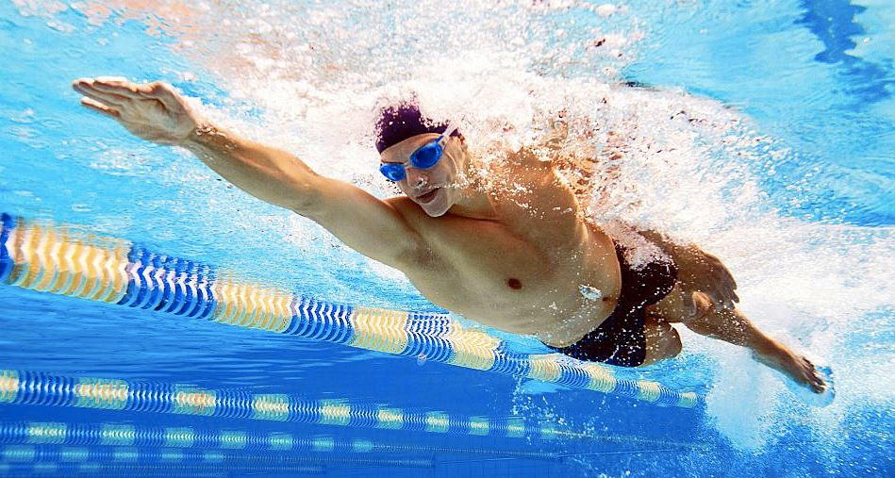
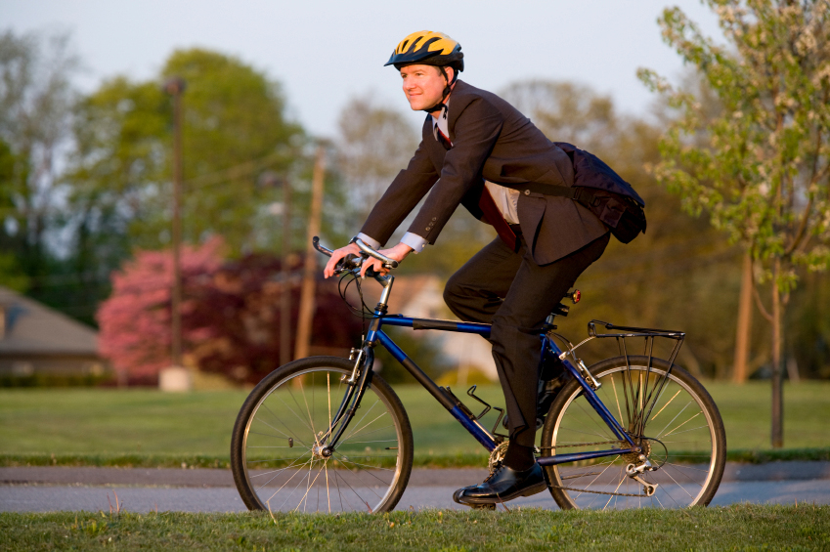
6. All About Me (and our culture)

Slide 7
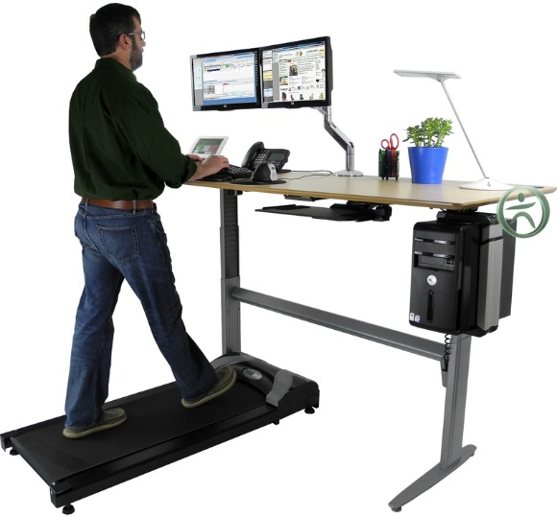
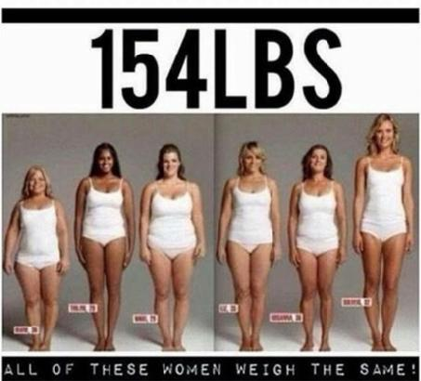
5. Productivity & Performance
vs. Health Costs & Stats

Slide 8
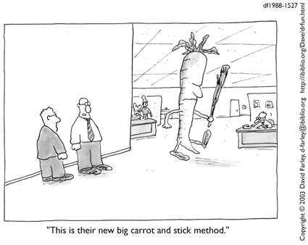
4. Business Strategy
vs. Penalty

Slide 9
3. Meaningful Outcomes
People who exercise for 30 minutes in the morning….
Are twice as productive in the last 2 hours of the day.
Effectively a 15% increase in productivity for that day!!
Source: Habits at Work BRATLAB research

Slide 10
2. Gamification

Slide 11
1. Low Tech Connectivity

Slide 12
Questions to Consider
Which of these things makes the most sense to you?
What could your workplace do to improve YOUR overall well-being?
Which of these trends are you already seeing/implementing as part of your wellness efforts at work?
Habit Focused
Holistic Approach
Multidisciplinary & Integrated
High Tech, BYOD, Connected
All About Me + Culture
Productivity & Performance Focused
Business Strategy
Meaningful Outcomes
Gamification
Low-Tech Connectivity

Slide 13
Coming in the Future…
Alaska’s first conference on
Performance & Productivity at Work
Tentatively May 2017
WhiteWater Wellness and other partner entities
If you are interested in volunteering, sponsoring, speaking or even attending, please email me your contact information:
cara@whitewaterwellness.com

Slide 14
Thank You!!
Cara Fairbanks
(907) 223-4883
cfairbanks@aleutcorp.com
Or
cara@whitewaterwellness.com

